Slide 1
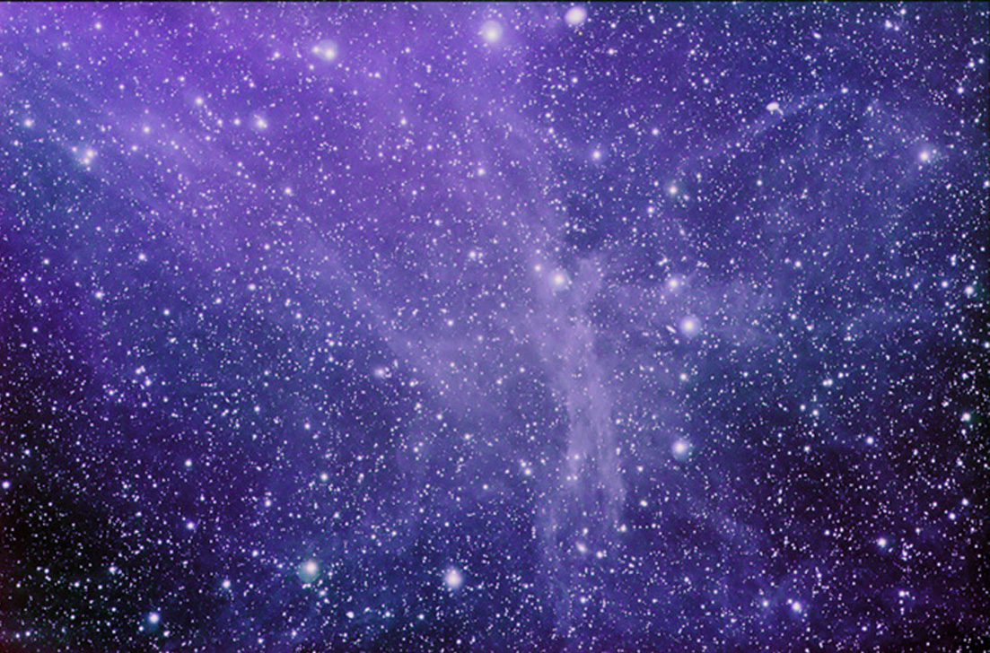
Linux Nebula 1.0 LTS
Now Playing: Whistle by Flo-Rida
10:20 pm

